Slide 1
RealTime Face Recognition Using IoT & IBM Cloud
G S SAI GANESH
CH ROHIT
ANAND RAJ

Slide 2
WORK FLOW
Detect Face
Recognize The Detected Face
Publish Detected Names to Cloud
Parsing The Cloud Data Through Node-Red
Dashboard
Mobile App

Slide 3
STANDARDS
OpenCV
IBM Cloud
Node-Red
MIT App Inventor

Slide 4
OBJECTIVES
Installing OpenCV.
Creating IBM Cloud Services.
Getting Service Credentials From IBM.
Creating Node-Red Flow.
Creating MIT-App.
Establishing Communication Between These Services.

Slide 5
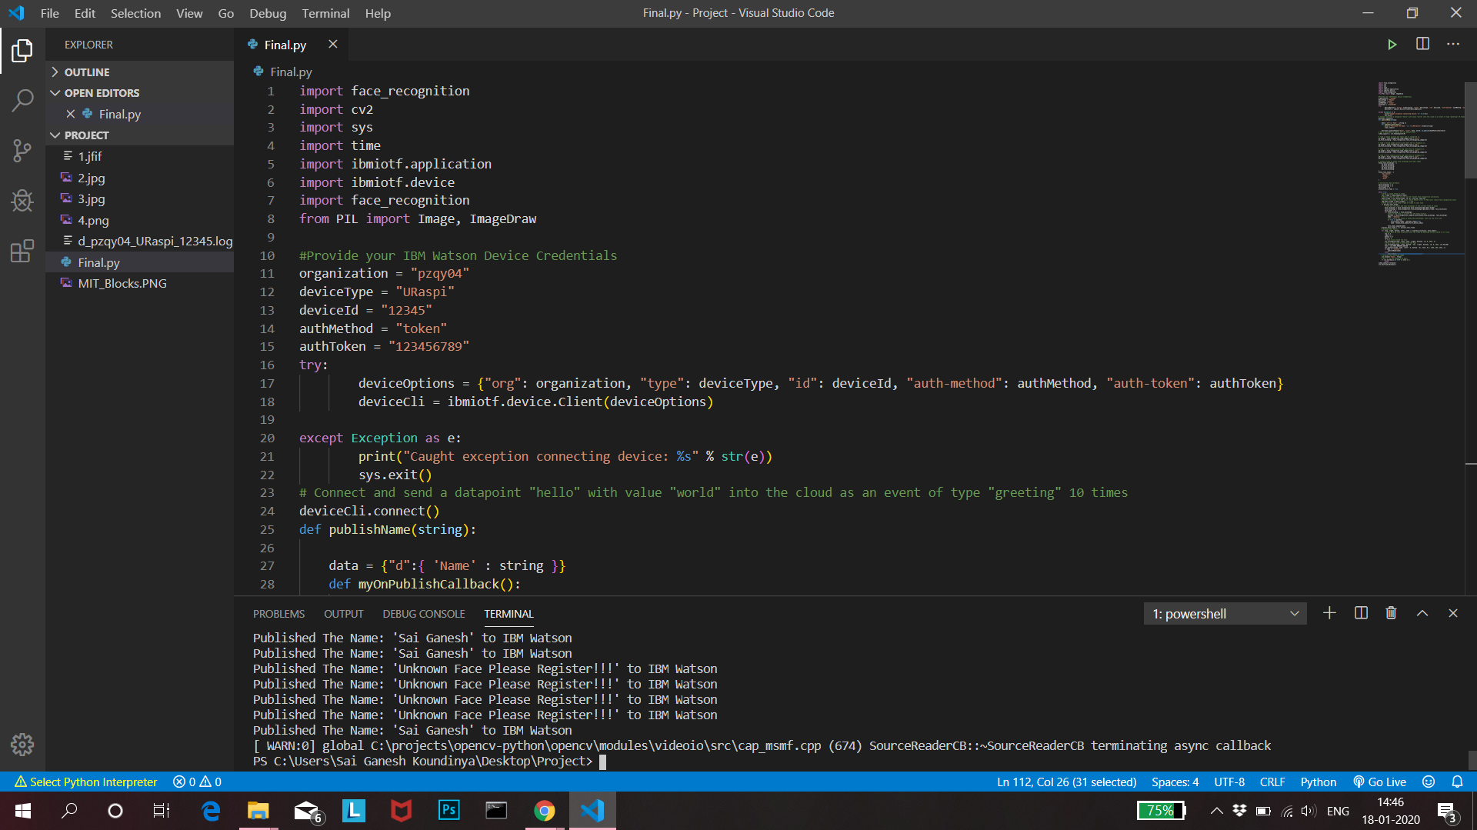
VISUAL STUDIO CODE

Slide 6
TASKS
Task 1 – Writing a Python Code
Task 2 – Importing Required Libraries Along with OpenCV.
Task 3 - Provide a set of images to the python code to utilize them as known faces.
Task 4 – Providing Services Credentials to Code.
Task 5 – Connecting to IBM Cloud with Providing Services Credentials.
Task 6 – Detect Faces from Each Frame.
Task 7 – Continuously Publish Detected Faces to the IBM Cloud.
Task 8 – Create a Node-Red Flow.
Task 9 – Create a Dash Board Through Node-Red.
Task 10 – Publish Detected Faces into URL Through Node-Red.
Task 11 – Create an MIT-App.
Task 12 – Continuously Retrieve Detected Faces into the MIT-App through the URL.
Task 13 – Display Corresponding Images for the Retrieved Face.

Slide 7
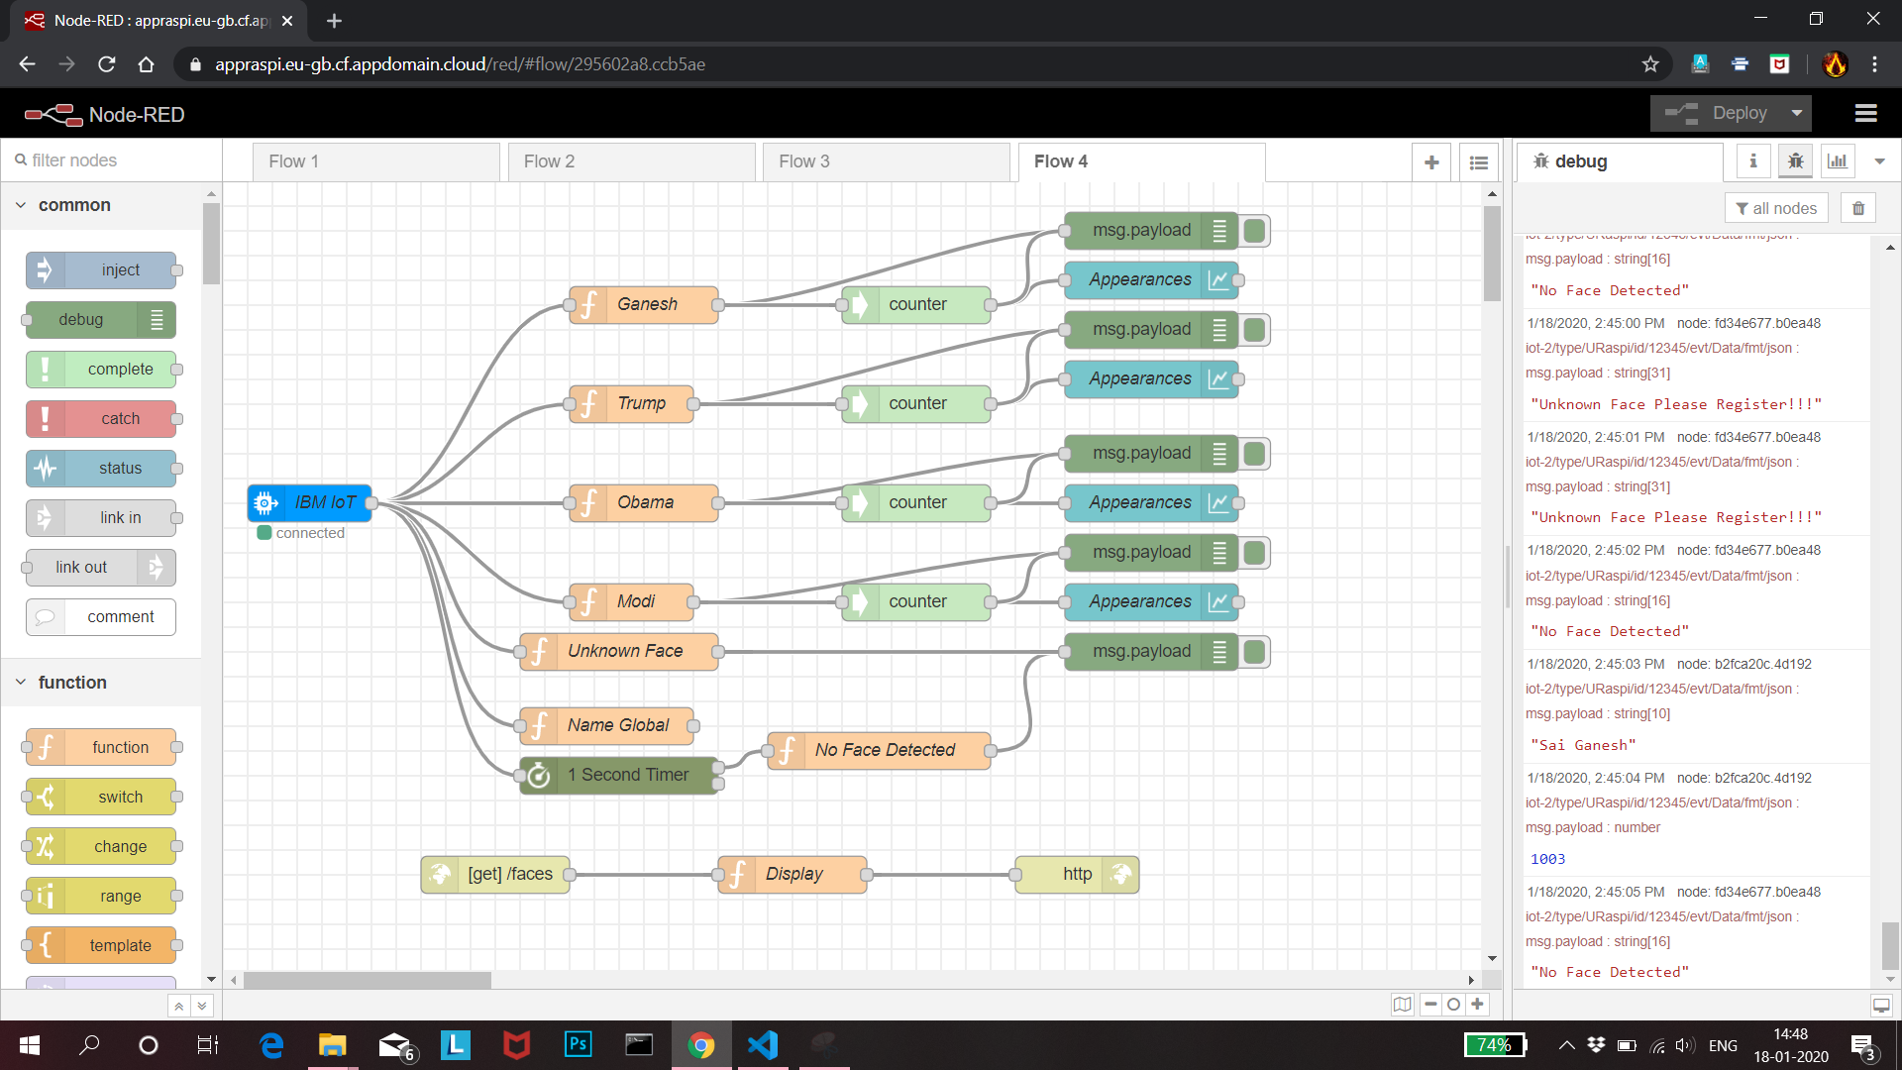
NODE-RED FLOW

Slide 8
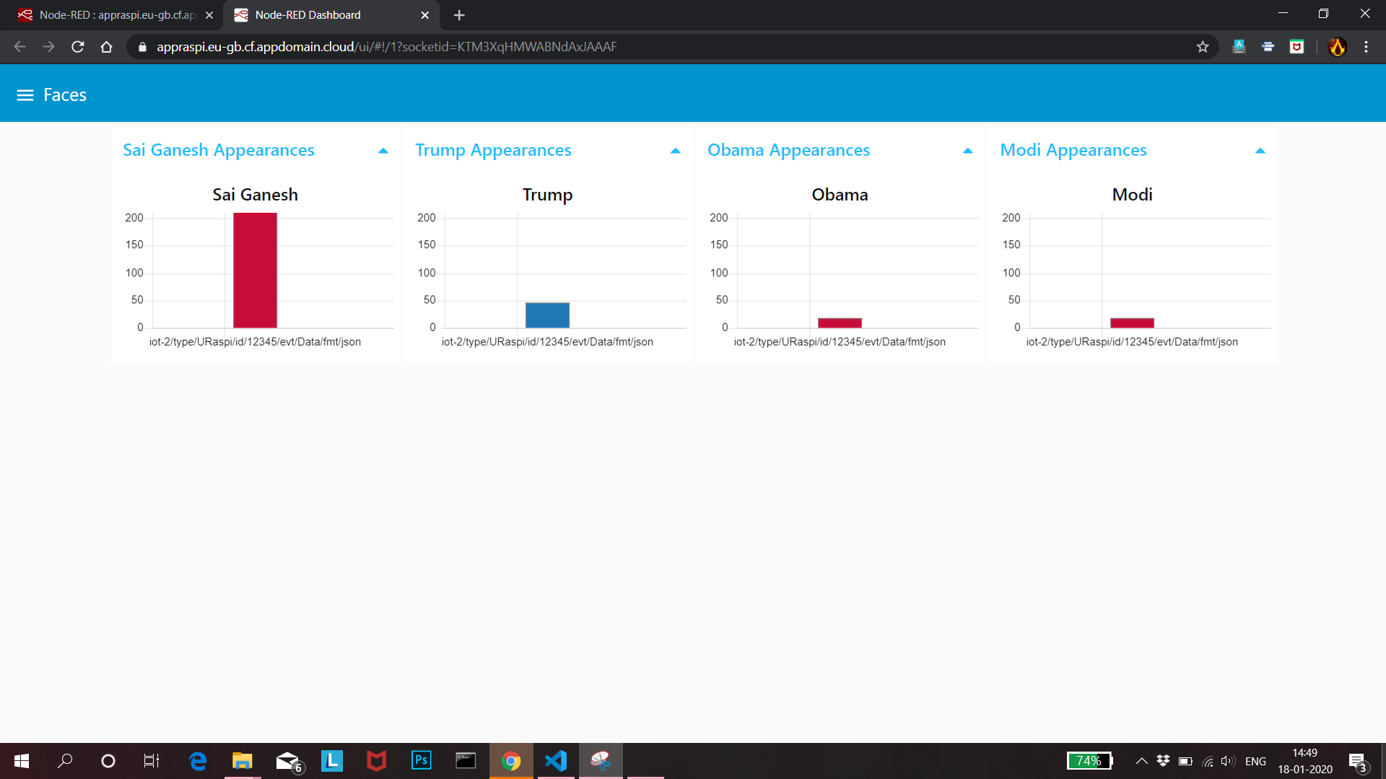
NODE-RED DASHBOARD

Slide 9
DESCRIPTION
A REAL TIME FACE RECOGNITION system is capable of identifying or verifying a person from a video frame. To recognize the face in a frame, first you need to detect whether the face is present in the frame. If it is present, mark it as a Region of Interest (ROI), extract the ROI and process it for facial recognition.

Slide 10
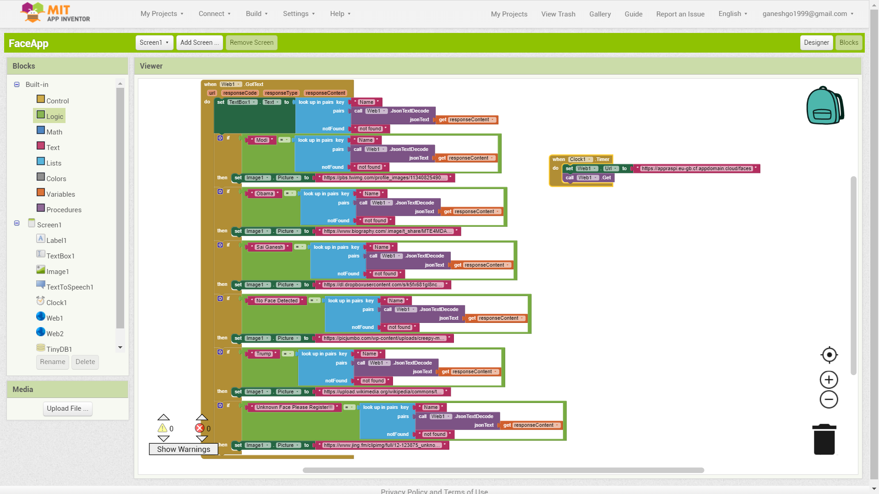
MIT BLOCKS

Slide 11
LINK TO OUR PROJECT
https://drive.google.com/open?id=1ynTJ-r4I1ukpda1dBMgKXMtwnT0fh6Dz

